Slide 1
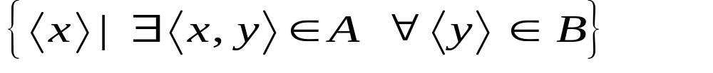
Division
Not supported as a primitive operator, but useful for expressing queries like:
  Find sailors who have reserved all boats.
Let A have 2 fields, x and y; B have only field y:
  A/B =
  i.e., A/B contains all x tuples (sailors) such that for every y tuple (boat) in B, there is an xy tuple in A.
  Or: If the set of y values (boats) associated with an x value (sailor) in A contains all y values in B, the x value is in A/B.
In general, x and y can be any lists of fields; y is the list of fields in B, and x ∪ y is the list of fields of A.
Principles of Database Systems, Xu Lizhen
Notes:
13

Slide 2
Examples of Division A/B
sno | pno
s1 | p1
s1 | p2
s1 | p3
s1 | p4
s2 | p1
s2 | p2
s3 | p2
s4 | p2
s4 | p4
pno
p2
pno
p2
p4
pno
p1
p2
p4
B1
B2
B3
sno
s1
s2
s3
s4
sno
s1
s4
sno
s1
A
A/B1
A/B2
A/B3
Principles of Database Systems, Xu Lizhen
Notes:
14

Slide 3
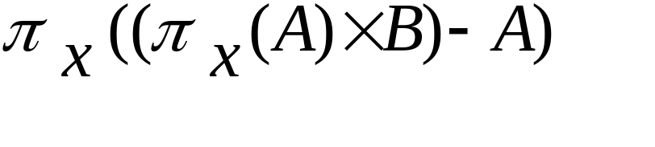
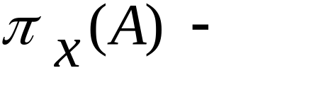
Expressing A/B Using Basic Operators
Division is not essential op; just a useful shorthand.
  (Also true of joins, but joins are so common that systems implement joins specially.)
Idea: For A/B, compute all x values that are not disqualified by some y value in B.
  x value is disqualified if by attaching y value from B, we obtain an xy tuple that is not in A.
Disqualified x values:
A/B:
all disqualified tuples
Principles of Database Systems, Xu Lizhen
Notes:
15

Slide 4
Outer Joins
The extension of join operation. In join operation, only matching tuples fulfilling join conditions are left in results. Outer joins will keep unmated tuples, the vacant part is set Null :
  Left outer join(*⋈)
  Keep all tuples of left relation in the result.
  Right outer join (⋈*)
  Keep all tuples of right relation in the result.
  Full outer join (*⋈*)
  Keep all tuples of left and right relations in the result.
Principles of Database Systems, Xu Lizhen

Slide 5
Examples of Outer Joins
S1
sid | sname | rating | age
22 | dustin | 7 | 45.0
31 | lubber | 8 | 55.5
58 | rusty | 10 | 35.0
R1
sid | bid | day
22 | 101 | 10/10/96
58 | 103 | 11/12/96
sid | sname | rating | age | bid | day
22 | dustin | 7 | 45.0 | 101 | 10/10/96
58 | rusty | 10 | 35.0 | 103 | 11/12/96
31 | Lubber | 8 | 55.5 | null | null
S1 *⋈ R1
sid | sname | rating | age | bid | day
22 | dustin | 7 | 45.0 | 101 | 10/10/96
58 | rusty | 10 | 35.0 | 103 | 11/12/96
S1⋈* R1 =
S1⋈R1 (Why?)
sid | sname | rating | age | bid | day
22 | dustin | 7 | 45.0 | 101 | 10/10/96
58 | rusty | 10 | 35.0 | 103 | 11/12/96
31 | Lubber | 8 | 55.5 | null | null
S1 *⋈* R1
Principles of Database Systems, Xu Lizhen

Slide 6
Outer Unions
The extension of union operation. It can union two relations which are not union-compatible.
The attribute set in result is the union of attribute sets of two operands.
The values of attributes which don’t exist in original tuples are filled as NULL
sid | sname | rating | age | bid | day
22 | dustin | 7 | 45.0 | null | null
31 | Lubber | 8 | 55.5 | null | null
58 | rusty | 10 | 35.0 | null | null
22 | null | null | null | 101 | 10/10/96
58 | null | null | null | 103 | 11/12/96
S1∪R1
Principles of Database Systems, Xu Lizhen

Slide 7
Relational Calculus
Relational Algebra needs to specify the order of operations; while relational calculus only needs to indicate the logic condition the result must be fulfilled.
Comes in two flavors: Tuple relational calculus (TRC) and Domain relational calculus (DRC).
Calculus has variables, constants, comparison ops, logical connectives and quantifiers.
  TRC: Variables range over (i.e., get bound to) tuples.
  DRC: Variables range over domain elements (attribute values).
  Both TRC and DRC are simple subsets of first-order logic.
Expressions in the calculus are called formulas. An answer tuple is essentially an assignment of constants to variables that make the formula evaluate to true.
Principles of Database Systems, Xu Lizhen

